Slide 1
The CMS Data Management System
M. Giffels, Y. Guo, N. Magini, T. Wildish, V. Kuznetsov

Slide 2
Outline
Introduction
Data Management in CMS: performance during LHC Run 1 and planned improvements for LHC Run 2
Architecture
Core components
Data bookkeeping – DBS
Data transfers – PhEDEx
Query and aggregation service – DAS
Additional services
Summary

Slide 3
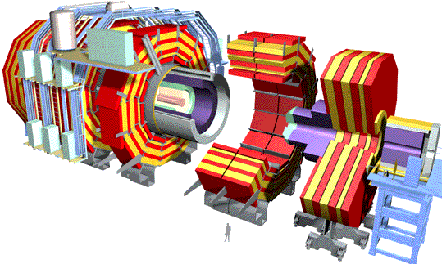
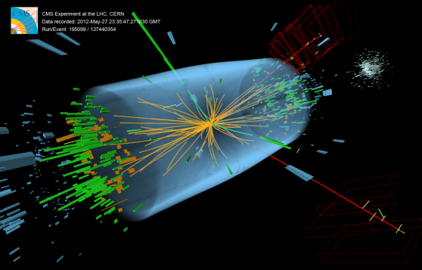


CMS Data
~10⁷ distinct files
in 2012
~10¹⁰ events/year
Event data in files
average file size reasonably large ~2.5 GB
Output merged to help scaling in catalogs and storages
Files are grouped in file blocks to manage them in bulk
~10-1000 files/block
File blocks are grouped by physics content in datasets of variable size (0.1–100 TB)

Slide 4
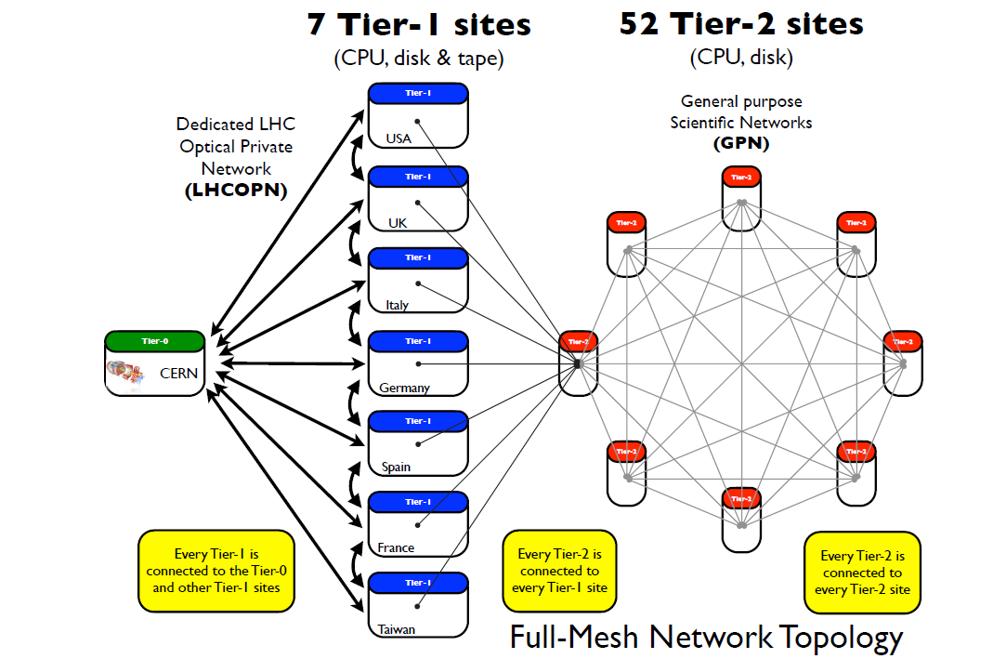

CMS Computing Infrastructure
Tier-0
Custodial storage of first copy of the data
Disk storage for prompt reconstruction and calibration
Distribution of data to Tier-1s
Tier-1s
Shared custodial storage of second copy of the data
Disk storage for data reconstruction and reprocessing
Distribution of analysis data to Tier-2s
Tier-2s
Disk storage for end-user physics analysis and Monte Carlo simulation
10-Oct-13
The CMS Data Management System - CHEP 2013
4

Slide 5
Data Management system
Tasks:
Data bookkeeping catalog: what are the data?
Data location catalog: where are the data?
Data placement and transfer management
For archiving and before processing: CMS job submission is mostly based on data location
CMS Architecture:
Independent core components dedicated to different tasks
Interacting with each other and with external services via webservices
Data from different components aggregated through dedicated service

Slide 6
Dataset Bookkeeping System (DBS)
Data bookkeeping: DBS
Data definition
What are the data, how they were produced
configuration, run number/luminosity, parentage
Data discovery
Which data exist, how they are organized in datasets/blocks/files

Slide 7
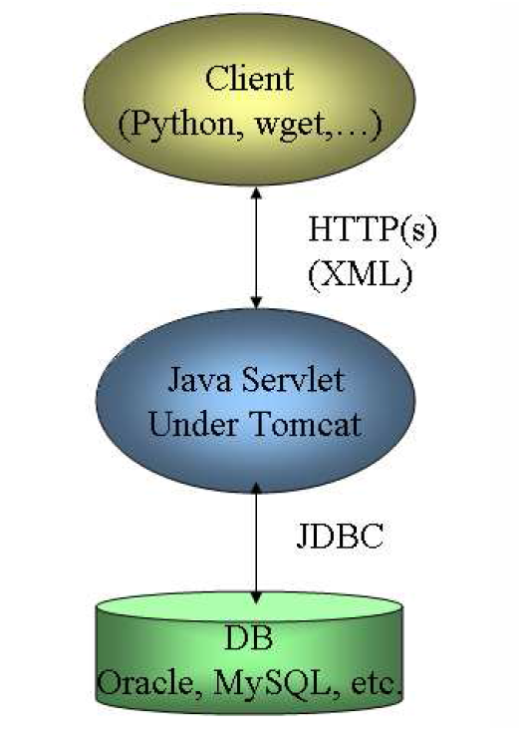
Dataset Bookkeeping System (DBS)
Current implementation: DBS2
SQL DB backend
Oracle currently used, more supported
Java servlets under Tomcat
XML format for client payload, requires client-side API
Current deployment
Multiple instances for different scopes
Global: all official CMS data
Tier-0: temporary during prompt reco
Analysis: user-produced data
APIs to migrate data between instances

Slide 8
Dataset Bookkeeping System (DBS)
DBS2 sustained the load during LHC Run 1
But some DBS2 assumptions had to be re-evaluated with operational experience
e.g. at the start of the run, the DBS webpage was the main interface for user data discovery, including data location, leading to scaling issues
INSERT PLOT WITH DBS2 NUMBERS DURING RUN1 HERE

Slide 9
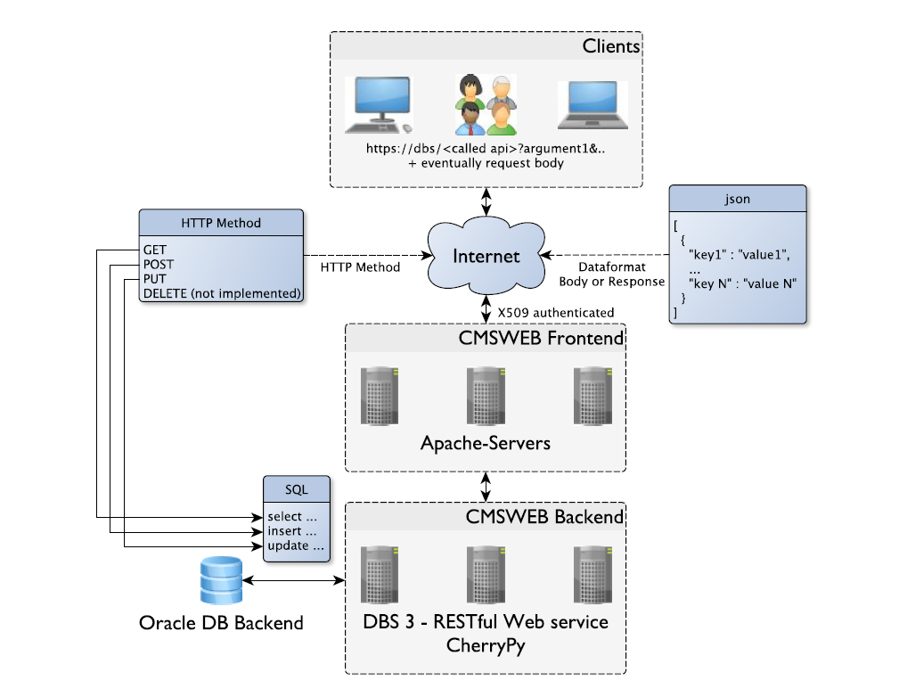
Dataset Bookkeeping System (DBS)
New version: DBS3
Rescoped schema in Oracle DB, dropping information that did not belong there e.g. data location
REST API based on standard cmsweb libs, SQLAlchemy and CherryPy
Lightweight information exchange with JSON
Currently deployed in parallel to DBS2 for validation before final switch

Slide 10
Dataset Bookkeeping System (DBS)
DBS3 SLIDE ON PERFORMANCE HERE?

Slide 11

PhEDEx
Data location and placement: PhEDEx - Physics Experiment Data Export
Each CMS site runs a set of agents
Independent, specialized perl daemons dedicated to fulfill a specific “simple” task
Central agents: routing, task assignment, …
Site-specific agents: download, mass storage staging and migration, deletion, consistency checks, …
Agents inter-communicate through a central Transfer Management DB (TMDB)
Oracle SQL backend
Web data service and interactive site

Slide 12
TMDB
Oracle SQL DB for:
Replica location catalog
Tracked at the level of blocks of files except during transfers, for scaling
Only site location of replicas is tracked
Mapping to physical file names on storage through TrivialFileCatalog: just a set of regexp rules published by the site
Transfer state blackboard
Highly volatile tables for file-level information on active transfer tasks
Monitoring tables with aggregated data

Slide 13
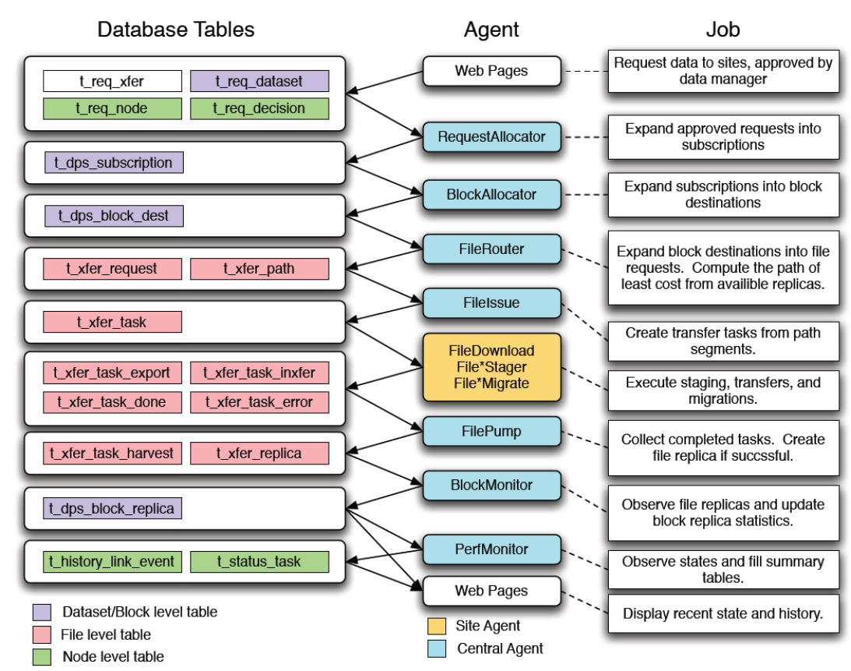
PhEDEx workflow

Slide 14
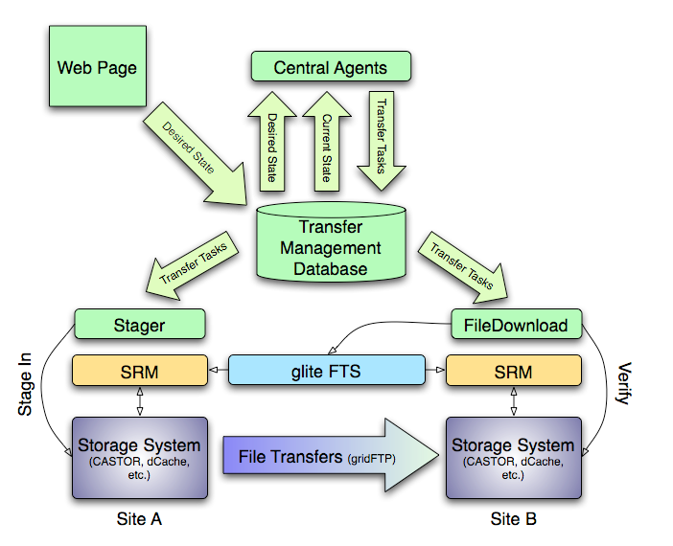
PhEDEx transfer workflow
PhEDEx is middleware-agnostic, integrated with WLCG DM middleware – e.g FTS or SRM - through plugins for site agents

Slide 15
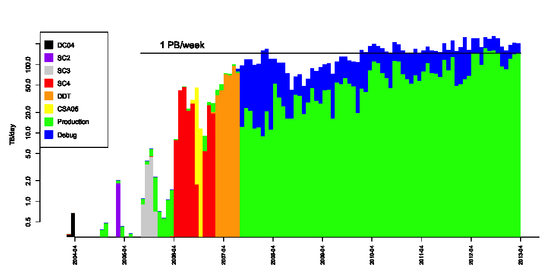
PhEDEx performance
NOTE: UPDATE PLOT!!!

Slide 16
PhEDEx improvements
PhEDEx scaling proved in simulation testbeds with ~100 higher rates/data volumes NOTE: ADD PLOT??
Recent and planned changes focused on adding support for more flexible workflows
Improved support for block transfers
Support for requesting generic operator actions e.g. consistency checking
Support for dynamic networking
…

Slide 17
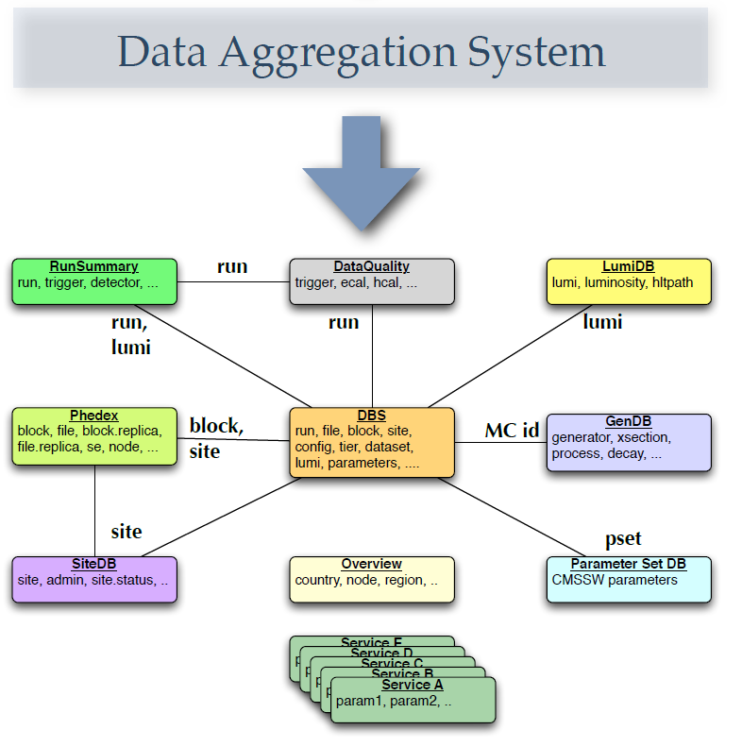
Data aggregation
Deploying independent, dedicated services ensures that each can be optimized for its own task
Disadvantage: users and services need to query multiple sources to get combined information, e.g.
find all sites hosting files for run=XXX
Solution: DAS Data Aggregation System

Slide 18
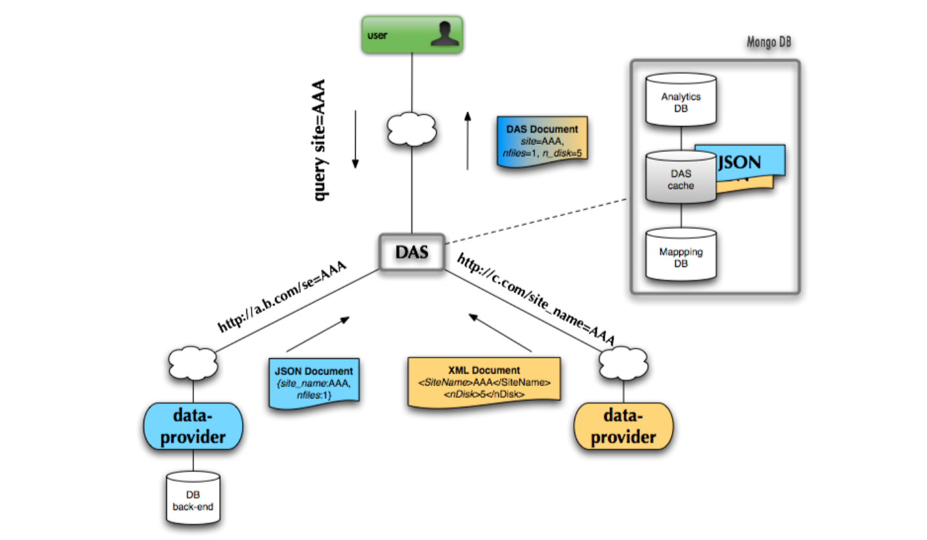
DAS
Aggregating data from multiple web sources without any requirement on data providers
DAS works with 15 distributed data-services
Data stored in NoSQL document-based database MongoDB
For caching and storing aggregated results

Slide 19
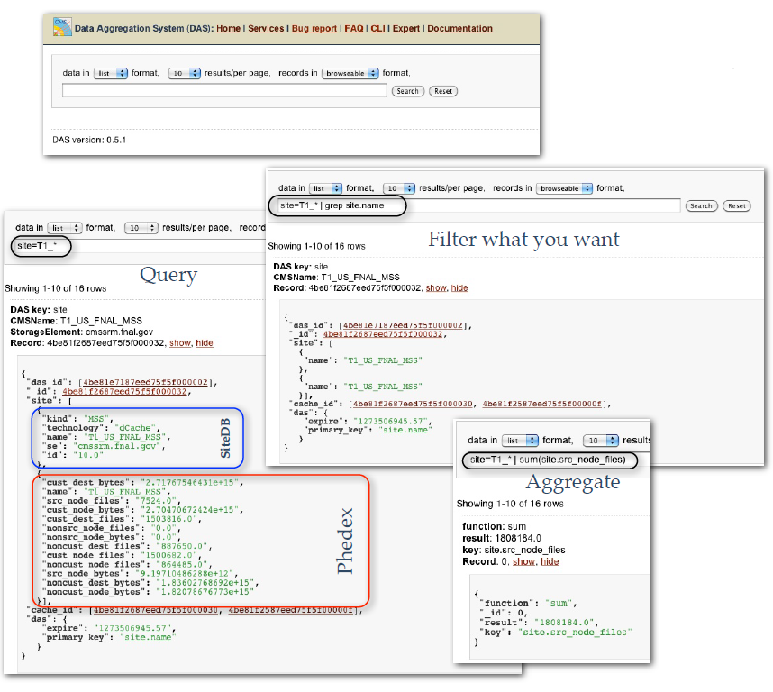
DAS interface
Free text-based query language, filters, aggregators
DAS interactive webpage fully replaced DBS webpage as main user entry point for data discovery in 2011

Slide 20
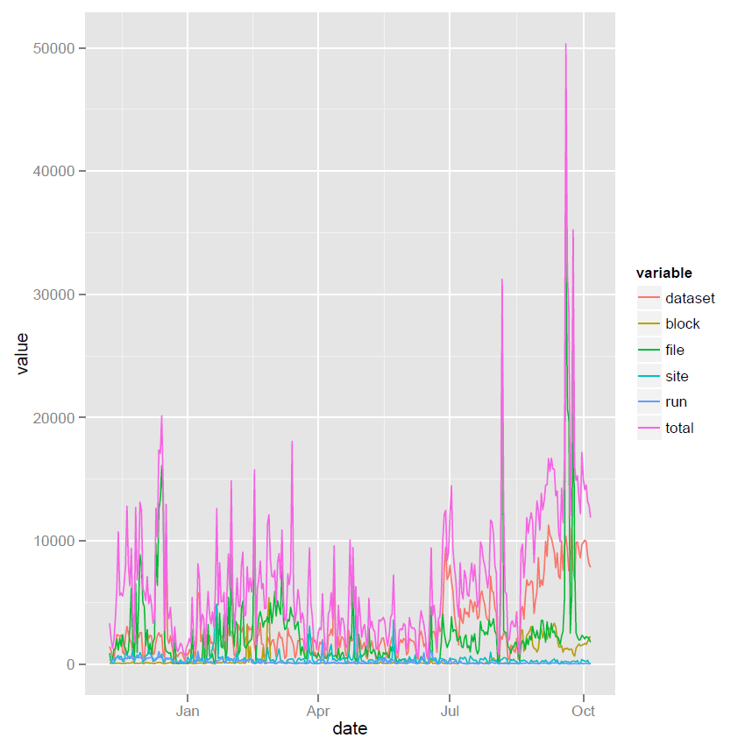
DAS performance
Input queries/day on DAS during 2013
Each query produces O(10-1000) results
On average O(10M) results entering and served from DAS cache every day

Slide 21
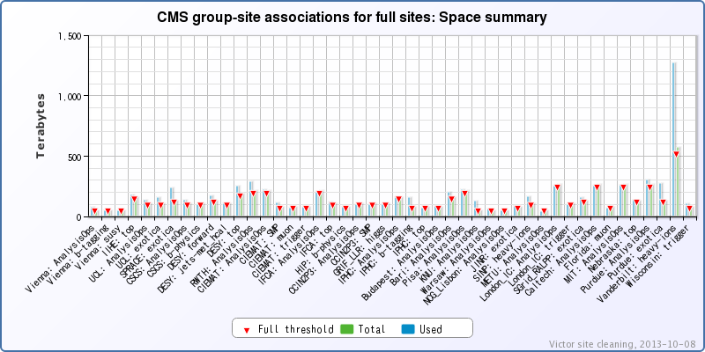
Additional services
External services can be easily interfaced to CMS DM components through their web services
Victor data cleaning deployed in 2011
Interfaced with PhEDEx and dataset popularity service to identify unused replicas that can be cleaned up
Next? Dynamic data placement service to trigger replication in PhEDEx of “hot” (popular) datasets

Slide 22
Summary
CMS Data Management based on independent core components individually optimized to ensure scaling
User interface provided by an Aggregation Service that integrates information from the underlying services
Using a common CMSWEB web service framework allows
independent development and evolution of underlying services
simplified integration and regression testing when rolling out new service versions
building external services that integrate information from several sources in a clean manner

